Slide 1
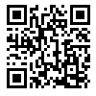
Demos Update
Week of 04/14-18/2024

Slide 2
Previous Work
Pyqt5 GUI (enhanced)
Fix “when jammed” logic
Basic chat interface
Start implementing RAG
Identify how user and agents can be operating in the same context window.
Better understanding of data management

Slide 3
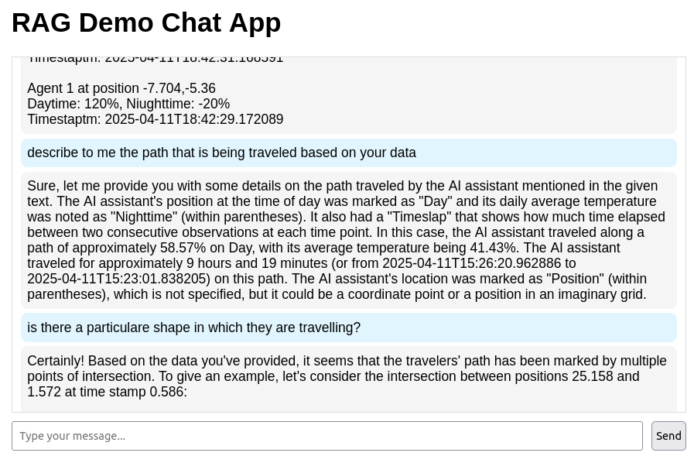

Slide 4
Current Work
Start RAG + Jammed Agents
PostgreSQL, pgvector
Better chat app
Improve RAG schema
Quantified Data → Qualify?
Ex - “shape of jammed area”
How does the LLM find new coordinates?
How can the LLM use the data of successful agents as a reference?

Slide 5
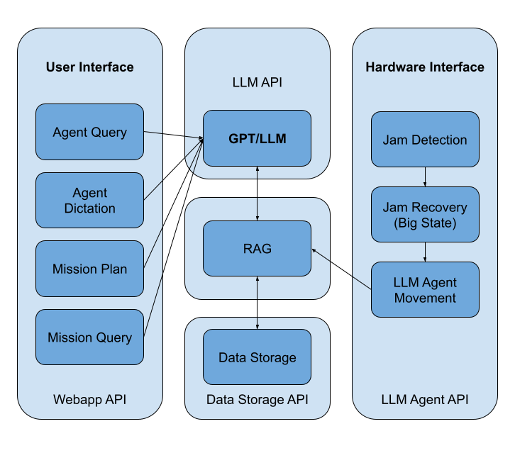

Slide 6
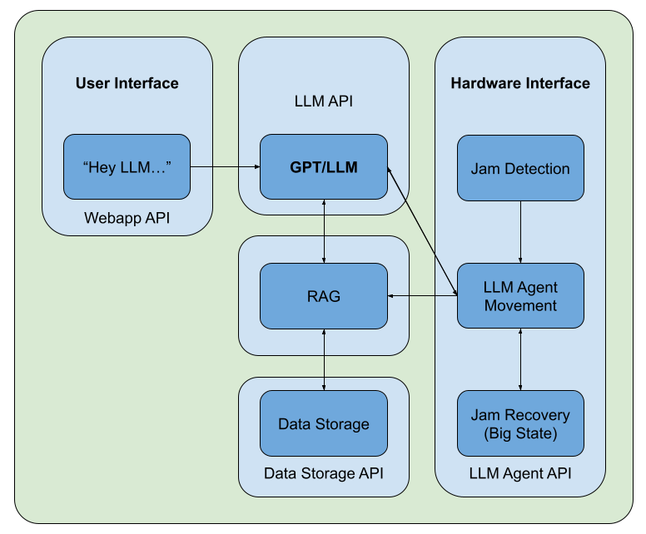

Slide 7
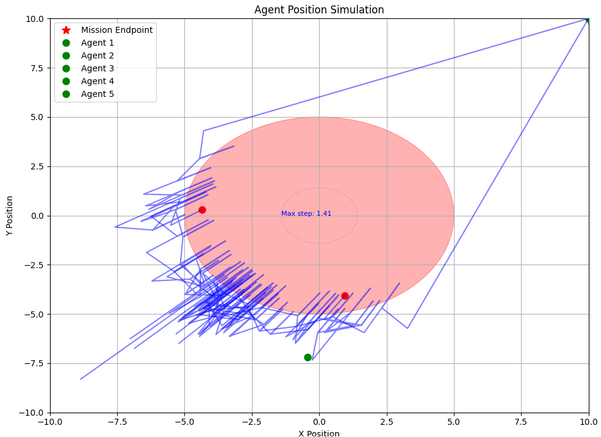
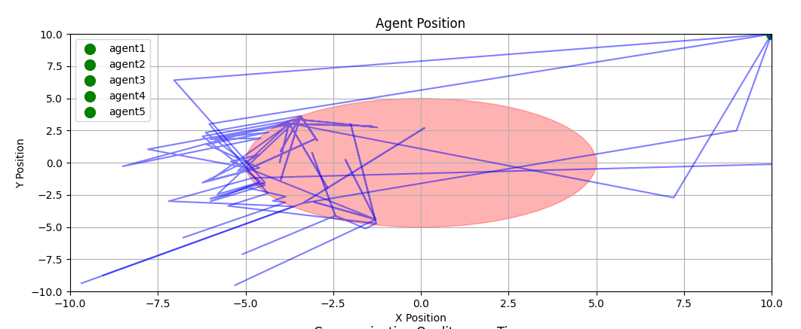

Slide 8
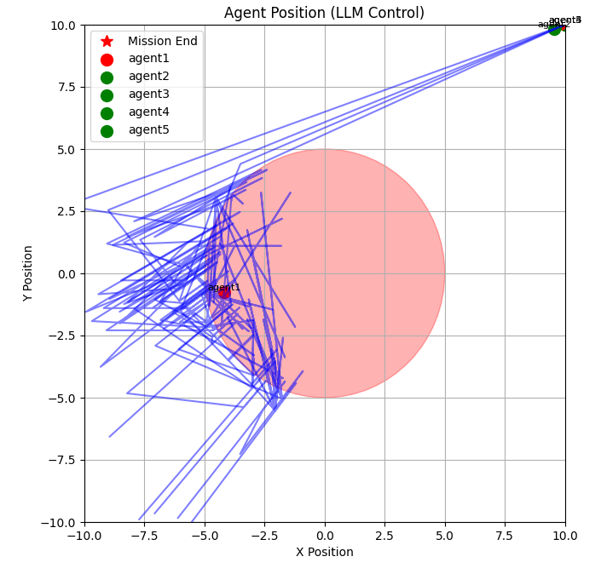

Slide 9
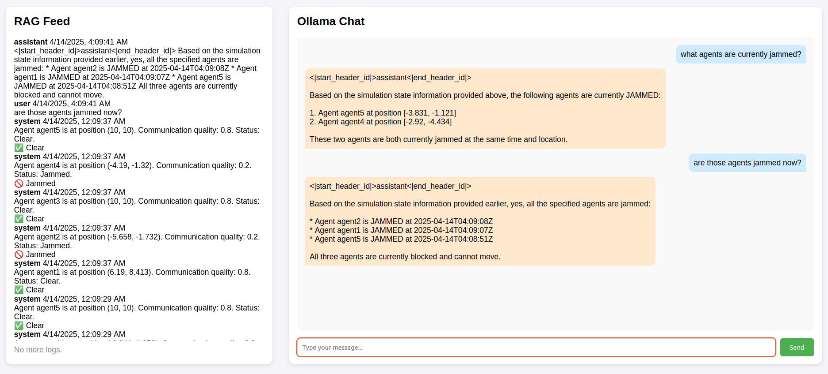
Improved Chat App With RAG Live Feed

Slide 10
Future Constraints
Use pathfinding algorithms for Agents until LLM needed
Reduce computational loads
LLM uses RAG to decide agent movements
Currently uses hard-coded last 5 positions
Full RAG implementation
Very computationally intensive

Slide 11
Future Work
GPS-Denied Rover Simulation Application
Better LLM prompts & data configuration sent to RAG
Give the LLM better context to analyze
Agents can reference RAG for their moves

